Slide 1

Manufacturing Downtime
Final Project Team 1

Slide 2








Team
Ahmed Yasser 01555804012 linkedin.com/in/ahmedyassermousa/
Supervised by
Dr. Amal Mahmoud
Mohamed El-Nady 01152455483 www.linkedin.com/in/mohamed--el-nady
Mohamed Adel
Abdulrahman Mohamad 01551474804
www.linkedin.com/in/abdulrahman-salahuddin

Slide 3
AGENDA
Introduction To Data
KPIs
Data Cleaning
Dashboard
Data Modeling
Insights

Slide 4
Introduction To Data
Definition:
Represents real industrial machine operation data
Data structure:
Time-based operational records
Multiple machines working simultaneously
Analysis Objective:
Measure operational efficiency
Calculate manufacturing KPIs
Build a management-level dashboard
Help In Maintenance ( Preventive – predictive )

Slide 5
Introduction To Data
Maintenance Type:
Preventive Maintenance
Scheduled maintenance based on time or usage
Aims to reduce unexpected failures and unplanned downtime
Predictive Maintenance
Data-driven maintenance based on machine condition
Predicts failures before they occur to optimize cost and downtime
Corrective Maintenance
Performed after a failure occurs
Focused on restoring equipment to normal operation

Slide 6
AGENDA
Introduction To Data
KPIs
Data Cleaning
Dashboard
Data Modeling
Insights

Slide 7
Data Cleaning
Purpose: Ensure data reliability before analysis
Reviewed missing values:
Verified missing values vs. zero values
Checked for outliers:
Extremely low or high RPM values
Validated logical constraints:
Production units ≥ 0
Downtime hours ≥ 0
Failures aligned with downtime
Preserved realistic operational data:
No aggressive outlier removal
Maintained real production behavior

Slide 8
AGENDA
Introduction To Data
KPIs
Data Cleaning
Dashboard
Data Modeling
Insights

Slide 9
Data Modeling
1. Identify Business Questions
Defined the main analytical questions:
Who is producing?
What is being produced?
When does production and failure occur?
Why do failures and maintenance actions happen?
2. Separate Fact and Dimension Data
Identified the fact table containing:
• Operating hours • Downtime • Failures type
Identified dimension tables to describe context:
• Machine • Product • Time
• Failure • Maintenance

Slide 10
Data Modeling
3. Create Analytical Dimensions (Who / What / When / Why)
Who → Machine Dimension (machine, type, brand)
What → Product Dimension (product type)
When → Time Dimension (date, day, month)
Why → Failure & Maintenance Dimensions
4. Use Keys to Build Relationships
Created surrogate keys for each dimension:
• machine_key • product_key
• date_key • failure_key
• maintenance_key
Linked all dimensions to the fact table using keys

Slide 11
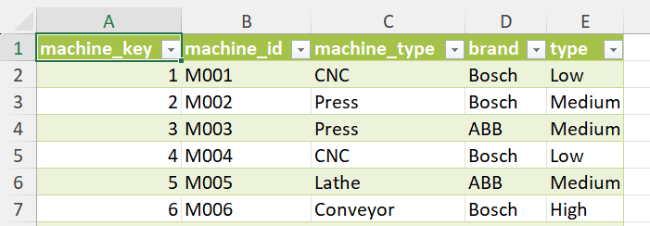
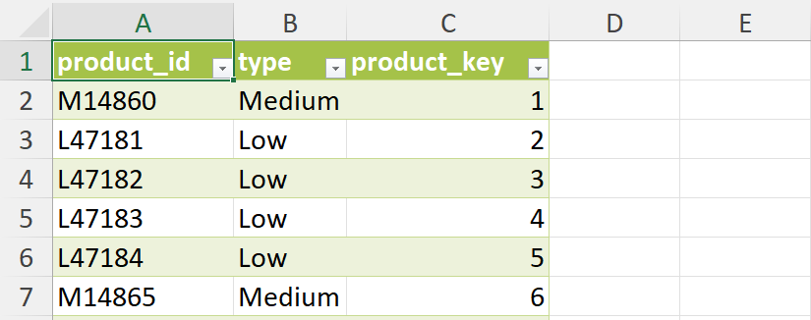
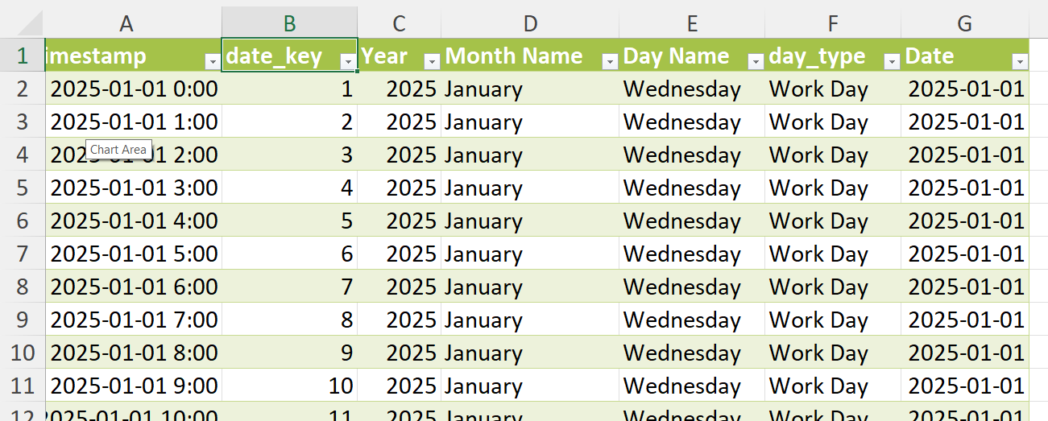
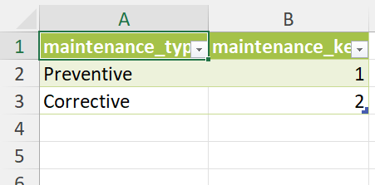
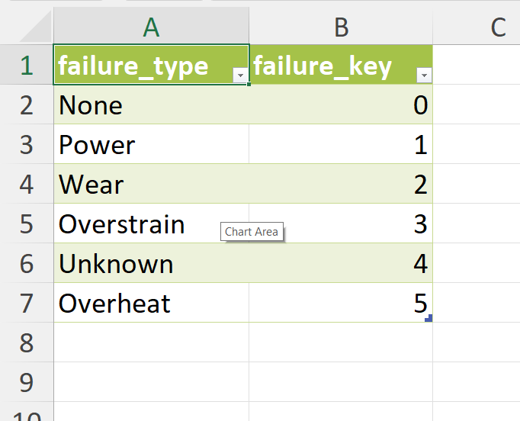
Data Modeling
WHO Analysis → DimMachine
WHAT Analysis → DimProduct
WHY Analysis → • DimFailure • DimMaintenance
WHO Analysis → DimDate

Slide 12
Data Modeling
5. Apply Star Schema Structure
One central Fact table
Multiple connected Dimension tables
Simplified joins for analysis and dashboarding

Slide 13
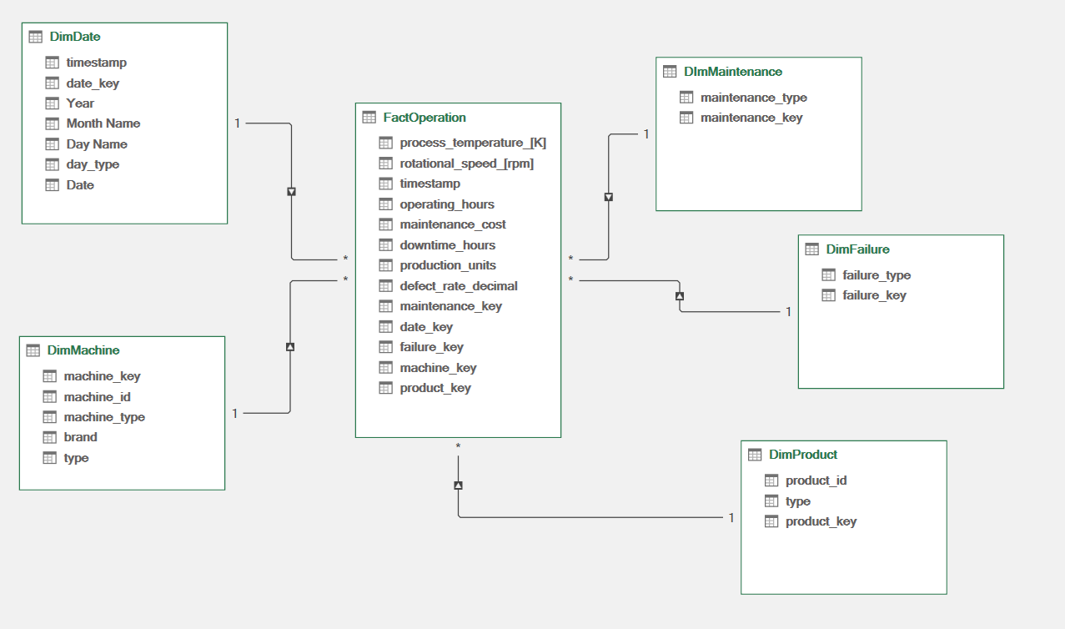
Data Modeling

Slide 14
AGENDA
Introduction To Data
KPIs
Data Cleaning
Dashboard
Data Modeling
Insights

Slide 15
KPIs
Availability → Downtime losses
Performance → Speed losses
Quality → Defect losses
OEE → Overall efficiency indicator
Maintenance KPIs → Reliability and repair effectiveness

Slide 16
KPIs
Availability
Measures machine readiness and uptime
Definition:
Percentage of time machines were available for production
Calculation:
(Operating Time − Downtime) ÷ Operating Time
Purpose:
Identify losses caused by breakdowns and maintenance
Insight:
High availability indicates stable machine reliability

Slide 17
KPIs
Performance
Measures how fast machines run compared to their maximum capability
Definition:
Actual production compared to theoretical maximum production
Calculation logic:
Based on actual RPM vs. maximum RPM per machine
Actual Output ÷ Theoretical Output
Purpose:
Detect slow-running and speed losses
Insight:
Low performance indicates underutilized machine capacity

Slide 18
KPIs
Quality
Measures production quality efficiency
Definition:
Percentage of good units out of total produced units
Calculation:
Good Units ÷ Total Units Produced
Purpose:
Identify losses caused by defects and rework
Insight:
High quality indicates stable and controlled processes

Slide 19
KPIs
Overall Equipment Effectiveness (OEE)
Measures overall manufacturing efficiency
Definition:
Combined indicator of availability, performance, and quality
Calculation:
Availability × Performance × Quality
Purpose:
Provide a single, comprehensive efficiency metric
Insight:
Highlights the main source of efficiency losses

Slide 20
KPIs
Maintenance KPIs
Evaluate maintenance effectiveness
MTBF (Mean Time Between Failures)
Measures average operating time between failures
MTTR (Mean Time To Repair)
Measures average time required to restore equipment
Cost per Failure
Total maintenance cost ÷ Number of failures

Slide 21
AGENDA
Introduction To Data
KPIs
Data Cleaning
Dashboard
Data Modeling
Insights

Slide 22
Dashboard
Ready?

Slide 23
AGENDA
Introduction To Data
KPIs
Data Cleaning
Dashboard
Data Modeling
Insights

Slide 24
Insights
Availability is relatively high, indicating that machine breakdowns are not the primary issue.
Quality levels are very high, showing stable production and low defect rates.
Performance is significantly lower than availability and quality.
The main efficiency loss comes from machines running below their maximum speed.
Slow-running conditions are the dominant factor impacting overall OEE.
Maintenance activities reduce downtime but do not fully address performance losses.
There is clear potential to improve OEE by optimizing operating speeds rather than increasing maintenance frequency.

Slide 25
Thank you
for your attention

